Slide 1
Land use map
January 18, 2019

Slide 2
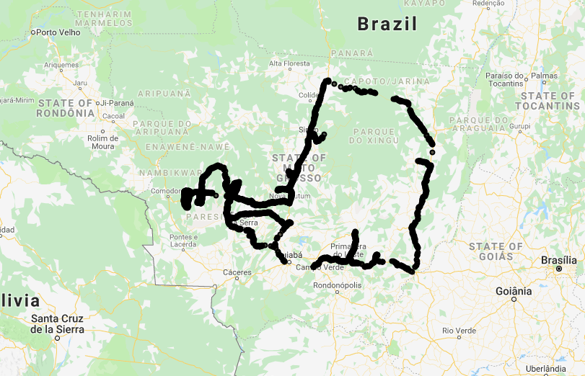
Jake’s original Soy Classification
GEE file: LandCover/Soy Classification Jake mb2_3
MODIS aqua
8-day, B1-5, 7
Aug 1 to Aug 1
Landsat NDVI
32 day, Aug 1 to Aug 1
Elev, slope, aspect, hillshade
class_img
Mask with Mapbio2.3
Final image: classed_img
Jake’s training points are only in Mato Grosso, but should be ‘accurately geolocated’
Variations on Jake’s classification:
Different set of training points (including Matopiba)
Masking training points with mapbiomas prior to training the classifier
Post-classification masking with mapbiomas3 (not 2.3)
Look at accuracy of classifiers in Mato Grosso vs Matopiba

Slide 3
Land cover classification variations
Training data
MODIS EVI, cloud filtered
Landsat EVI
SAR
Date of peak EVI
Sample soy points
soy_pts_1
Soy_pts_agsat_1
Classification regions
All
MT
Matopiba
Pre classification soy point filtering
None
Mapbiomas 2.3
Mapbiomas 3
classify
Main issues:
DC vs SC is hard to distinguish
Soy points may not be correctly geolocated and sparse outside of Mato Grosso
Accuracy metrics for choosing among options above:
Confusion matrix -> acc, consumers/producers acc
Planet labs imagery
Base classified image (masked with Map 3)
Additional masking (connected pixels will produce a new asset)
Connected pixels
Reasonableness of timing estimates
Consistency across soymaps
Final classified images

Slide 4
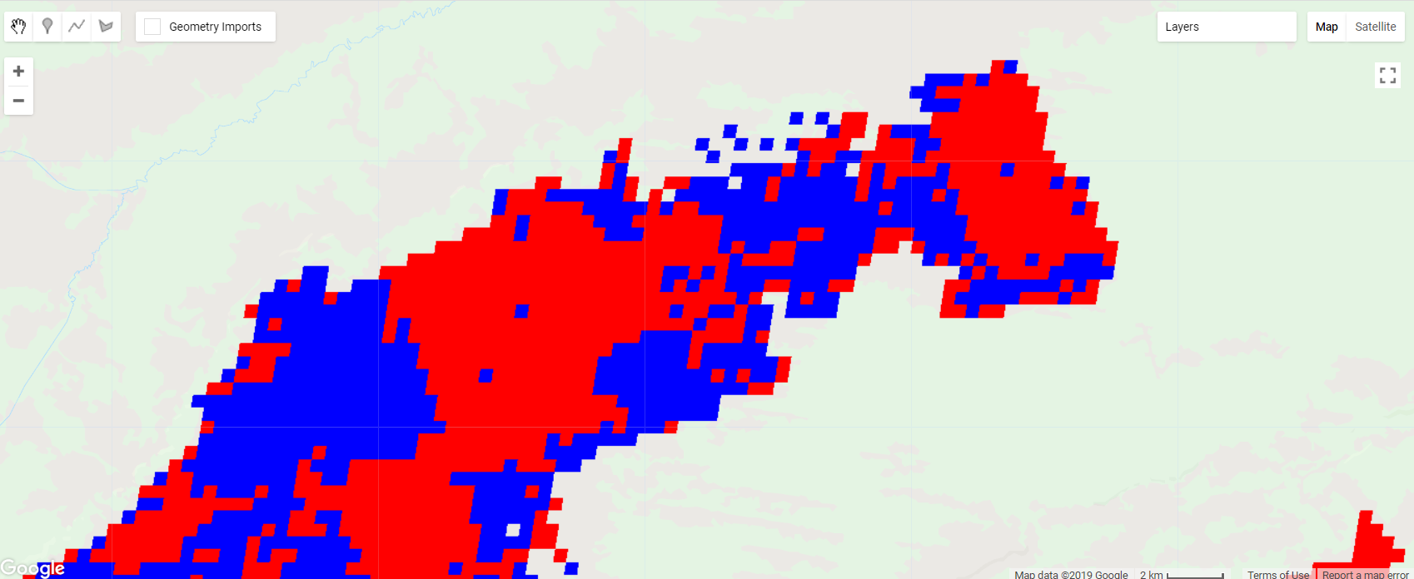
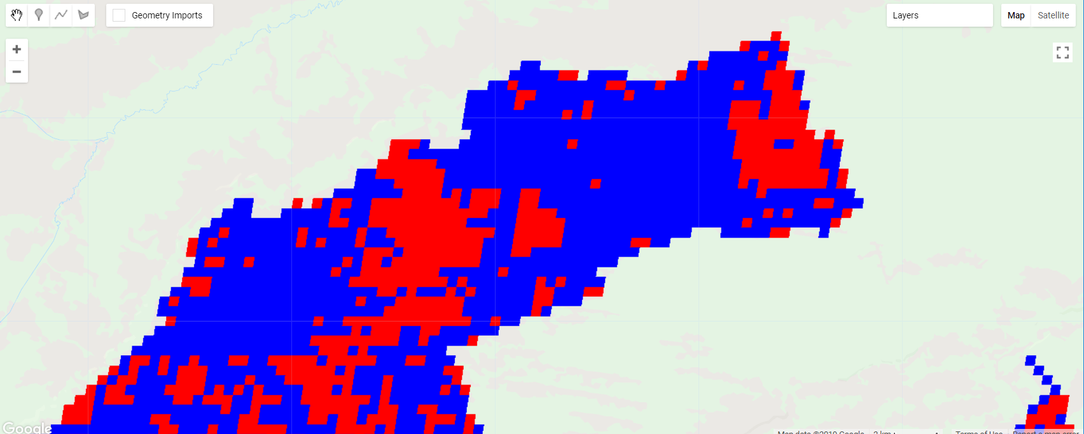
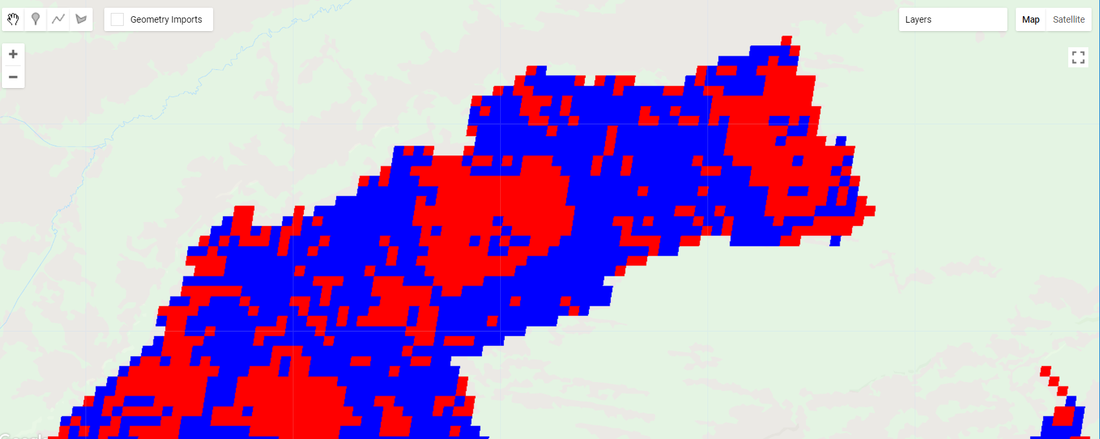
Matopiba: example of DC vs SC classification in 2017
Jake’s original soymap
Jake’s original classification:
Training points are of soy_pts_agsat_1
Training points were not masked prior to classification
Classified image was masked with Map2.3
Base_soymap
Differences from Jake’s map:
Training points are soy_pts_1 instead of soy_pts_agsat_1
Training points were masked with Map3 prior to classification
Classified image was masked with Map3 instead of Map2.3
Base_soymap_agsat
Differences:
Training points were masked with Map3 prior to classification
Classified image was masked with Map3 instead of Map2.3

Slide 5
Next:
Add new training data
Finish ‘quality masking’ of soymaps, including ‘consistency mask’
Center pivot classification
Get Planet imagery for DC vs SC training data
Separate or lump DC/SC in timing images?

Slide 7
Land use
Define current land use map’s accuracy
- List areas for improvement (by region? by SC vs DC?)
Read up on SAR and contact person for SAR cleaning
Determine Planet imagery locations for land use training and validation, classify by eye
SAR calibration
Center pivot training
New training points from Planet Labs imagery
mapbio3
SAR
Landsat
MODIS
Classification
Soy vs not soy, irrig vs nonirrig, SC vs DC
Validation
Validation points: Jake’s training points (SC vs DC), mapbiomas3, 2014 center pivot, CAR imovel in Matopiba and maybe MT, Planet visual inspection (especially for places outside of MT)
Does it make sense to separately map SC and DC?
Need SAR? Different classifiers per region?
Compare to Jake’s old land use map
Validation for failed first crops and differently timed crop cycles across the country
Extra masking
- Mask MODIS pixels with >80% area classified as soy (by Landsat or mapbiomas3)
- Highlight pixels with the same soy classification over large areas, pick the ones at the center of homo areas
Final soymaps at 30m and 500m

Slide 8
Land use exploration tasks
For Planet Lab imagery: figure out how to look at cloud cover stats and temporal resolution during planting time before choosing specific images to download. Look for enough temporal resolution to tell SC vs DC, first crop or second crop. Figure out sampling technique to choose which images to download.
For Planet Lab imagery: lit review on how people calibrate images
Does Mapbiomas 3 do a better job of mapping agri than Jake’s map does? (i.e. do estimates seem more reasonable? Do the small and irregularly shaped patches of natural veg seen in Planet Labs show up in mapbiomas? Is it reasonable to enhance the land use map with timing estimates?)

Slide 9
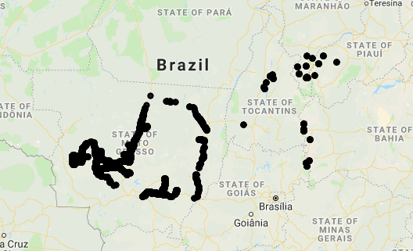
Jake’s original Soy Classification
GEE file: LandCover/Soy Classification Jake mb2_3
Sets of training points:
Kastens training points(kpts) are near roads and only in MT, total 3185 points
‘soy_pts_agsat_1’ are also only in MT, total 21383
‘soy_pts_1’ have some in Matopiba and majority in MT, total 32520
Need more training points across Brazil
Soy_pts_1
Kastens training pts

Slide 10
Jake’s original Soy Classification
GEE file: LandCover/Soy Classification Jake mb2_3
Inputs to classifier
MODIS aqua 8 day composite, bands 1-5 and 7 between Aug 1 of prev year and Aug 1 of current (classified) year (no extra cloud filtering) (276 per year)
Landsat NDVI 32 day composite (only 10 per year) – note that the original Landsat resolution is still kept in the final classifier image
SRTM (elevation, slope, aspect, hillshade)
‘infill’ all these bands with focal mean. Afterward, the infilled image has less ‘sharp’ gradients and a lower range of values. (purpose is to fill in missing values or to adjust the actual pixel values? Why do we need this?)
Reduce over the infilled classifier images at locations of the soy data points, use ‘sample_infill’ to fill in null values in sampled collection with feature means
Randomly choose 70% to train and 30% to test
Training and testing classifier
Train the classifier on the infilled image
Calculate accuracy of the classifier
Take pre-infilled image, mask with mapbiomas 2.3, and apply classifier to it to get the final classified image

Slide 11
Jake’s original Soy Classification
GEE file: LandCover/Soy Classification Jake mb2_3
MODIS aqua
8-day, B1-5, 7
Aug 1 to Aug 1
Landsat NDVI
32 day, Aug 1 to Aug 1
Elev, slope, aspect, hillshade
class_img
infill
ft_img
Reduce over data points
training pts (70%)
testing pts (30%)
Mask with Mapbio2.3
train
Class_img_ag
Classify image
classifier
accuracy
Final image: classed_img
Legend for classed_img:
Single soy = 0
Double soy = 1
Other agri = 2
Legend for mapbiomas:
Map2.3: agri = 18
Map3: agri = 19

Slide 12
Land cover classification flow
GEE file: LandCover/Soy Classification Variations
Training data
MODIS EVI, cloud filtered
Landsat EVI
SAR
Date of peak EVI
Sample soy points
soy_pts_1
Soy_pts_agsat_1
Classification regions
All
MT
Matopiba
Pre classification soy point filtering
None
Mapbiomas 2.3
Mapbiomas 3
classify
Accuracy metrics for choosing among options above:
Confusion matrix -> acc, consumers/producers acc
Planet labs imagery
GEE file: LandCover/Soy Classification Masking
Base classified image (masked with Map 3)
Additional masking (connected pixels will produce a new asset)
Connected pixels
Reasonableness of timing estimates
Final classified images

Slide 13
Soy Classification modifications
GEE file: LandCover/Soy Classification Variations
Variations on classification
New training data:
MODIS EVI
Cloud filtered MODIS
Pre classification masking of soy points:
None (original Jake)
Mapbiomas 3
Mapbiomas 23
Post classification masking of classified image:
Mapbiomas 3
Neighbors (i.e. pixel classified without any similar neighboring pixels will be taken out)
Variations on evaluation
Overall accuracy from confusion matrix
Accuracy by region (MT and Matopiba)
‘reasonableness’ of timing images
Observations based on accuracies exported from Soy Classification Variations:
Pre-classification masking of soy_pts_agsat_1 improved overall accuracy for both MT and ‘total’ (which is basically just MT for soy_pts_agsat_1). The improvement isn’t as clear for soy_pts_1. MT did worse under map3 preclassification masking; Matopiba wasn’t sensitive to preclassification masking; and the total accuracy was better with map3 preclassification masking.
Accuracy didn’t improve a lot in most cases… maybe from mid/low 70s to mid/high 70s
Training points create very different accuracies. Using soy_pts_agsat_1 gives accuracies in mid/high 70s, using soy_pts_1 gives accuracies in mid 60s. Need to use map3 as evaluation.
Applying the same classifier across Brazil gives similar accuracies as applying separate classifiers trained for MT-only or Matopiba-only points.

Slide 14
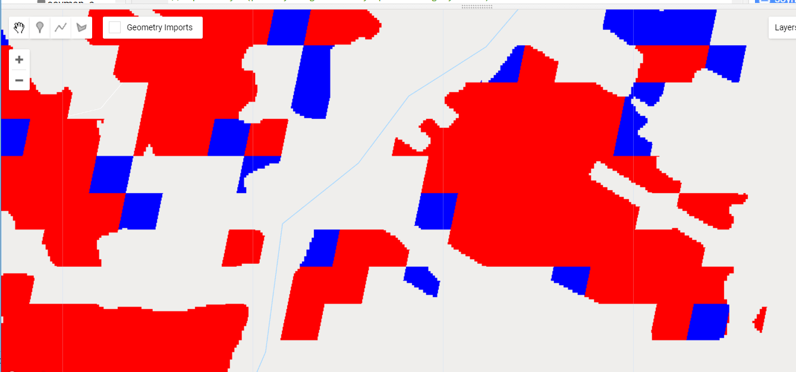
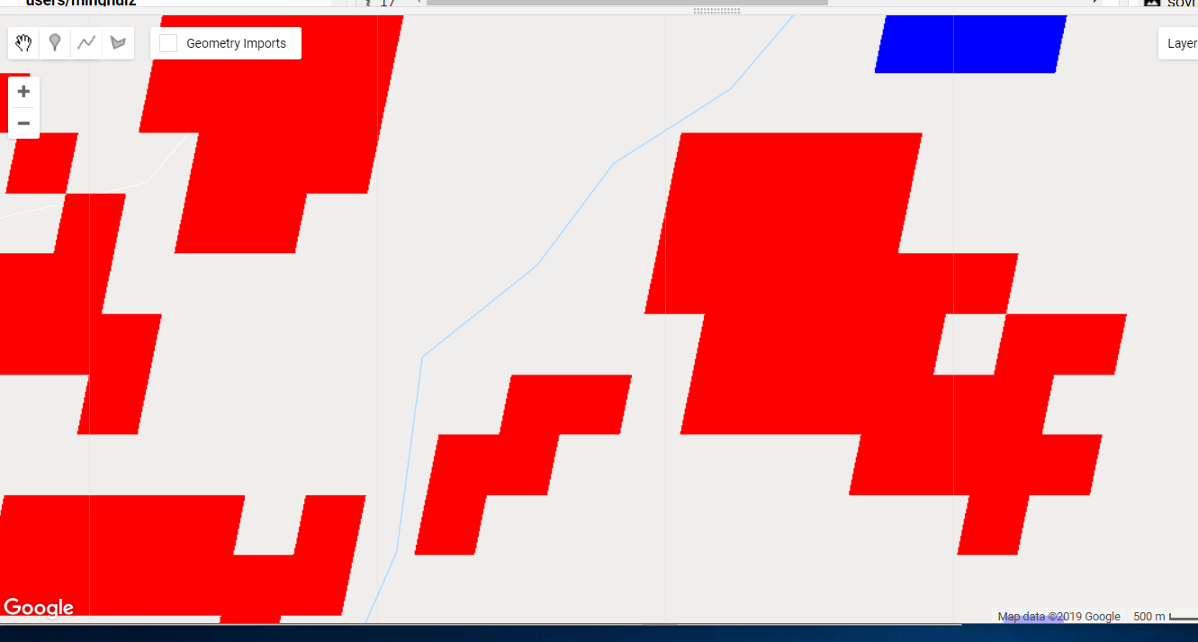
‘Secondary masking’ of raw MODIS-derived soy maps
GEE file: LandCover/Soy Classification Masking
Need to create separate soymap GEE assets with different mask levels because:
Masking soymap at 500m with map3 and displaying directly in the GEE Map area will create ‘partial pixels’. Need to export it as GEE asset, then it will display only full pixels.
Similarly, using connectedPixelCount will return all connected pixels at very zoomed in Map levels. Need to export to asset at a given scale in order to retain the correct connectedPixelCount at all zoom levels at the map.
It will be easier to compare e.g. the accuracy of unmasked soymap using map3 if there are separate unmasked and map3-masked soymap assets.
CANNOT use mapbiomas3 as an accuracy metric because need to mask by an agriculture dataset – otherwise, the ‘raw’ version will cover all area (i.e. all of the input MODIS and Landsat image coverag)
Masked 500m soymap with map3, shows partial pixels in GEE Map area.
Final masked image, masked by map3 and by connected pixels. Note there are still ‘floating’ DC pixels; this is because there wasn’t an asset export between masking by map3 and masking by connected pixels.

Slide 15
Soy maps produced as GEE Assets. Called base_(extraMasks)_soymap_agsat_year or base_(extraMasks)_soymap_year
Map 1 (base): Raw MODIS-derived soy map (export as asset in ‘Soy Classification Variations’)
Jake’s original training images (MODIS 8 day, Landsat EVI 32 day, elevation)
Training dataset is soy_pts_1 or soy_pts_agsat_1 (points are preclassification masked with mapbiomas3)
Trained and used the same classifier for entire Brazil, didn’t separate by MT vs Matopiba
Post classification mask to mapbiomas3
‘base’ refers to the bullet points above
Map 2 (base_connectionMask): Map 1 masked by connectedPixelCount (export as asset in ‘Soy Classification Masking’)
Map 3 (base_connectionMask_timingMask): Map 2 masked by ‘reasonableness’ of crop timing estimates (export as asset in ‘Soy Classification Timing’)
GEE file: LandCover/Soy Classification Variations and LandCover/Soy Classification Masking

Slide 16
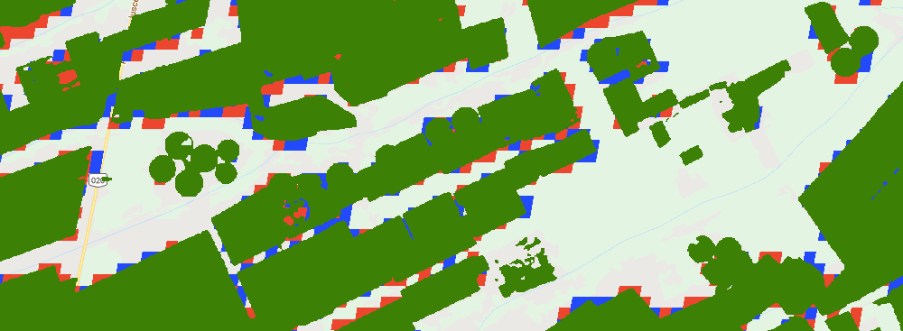
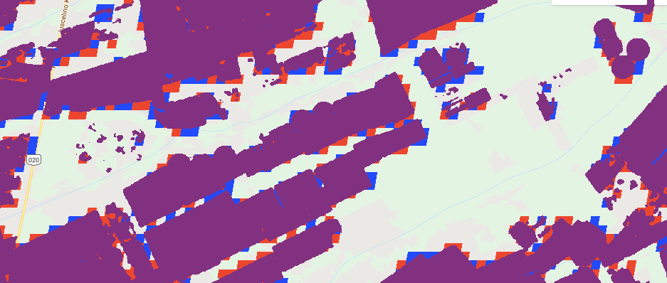
GEE file: LandCover/Soy Classification Masking
Green = mapbiomas 3
Purple = mapbiomas 2.3
Map3 seems to be able to catch center pivot better!

Slide 17
Observations: visual comparison of my base maps and Jake’s original soy maps
There’s only about a 10% difference in extent of soy area between jake’s original soymap (GEE asset users/cloudymccloudface/cohnlab/agroserv/soy_sc_dc_agsat_mod_ls) and the base maps that I produce. Makes sense because Jake’s was masked with map2.3 and mine was masked with map3.
However, there’s a huge difference in the pixel-level split of SC vs DC among my two base maps and Jake’s map. This makes sense because timing is completely different, so there’s no single way to divide e.g. the 8 day MODIS composites or 32 day Landsat composites in a way that suits all crop timings
From output of Soy Classification Variation, SC has only about 40% consumer’s accuracy and DC has about 70-85%. Probably because there’s a lot more DC in the dataset to begin with?
In 2014, after masking out Matopiba points by mapbiomas3, there are only 9 points left… not enough to see if Matopiba needs to be treated separately.
To address this issue:
There needs to be an additional mask based on ‘reasonableness’ of estimated crop timing
Incorporate ‘date of peak EVI’ as training information
Mask by consistency in DC vs SC across soy maps

Slide 18
Matopiba: example of DC vs SC classification in 2017
Jake’s original soymap
Jake’s original classification:
Training points are of soy_pts_agsat_1
Training points were not masked prior to classification
Classified image was masked with Map2.3
Base_soymap
Differences from Jake’s map:
Training points are soy_pts_1 instead of soy_pts_agsat_1
Training points were masked with Map3 prior to classification
Classified image was masked with Map3 instead of Map2.3
Base_soymap_agsat
Differences:
Training points were masked with Map3 prior to classification
Classified image was masked with Map3 instead of Map2.3

